Slide 1
Challenges of Steam Turbines for New Nuclear Technologies

Slide 2
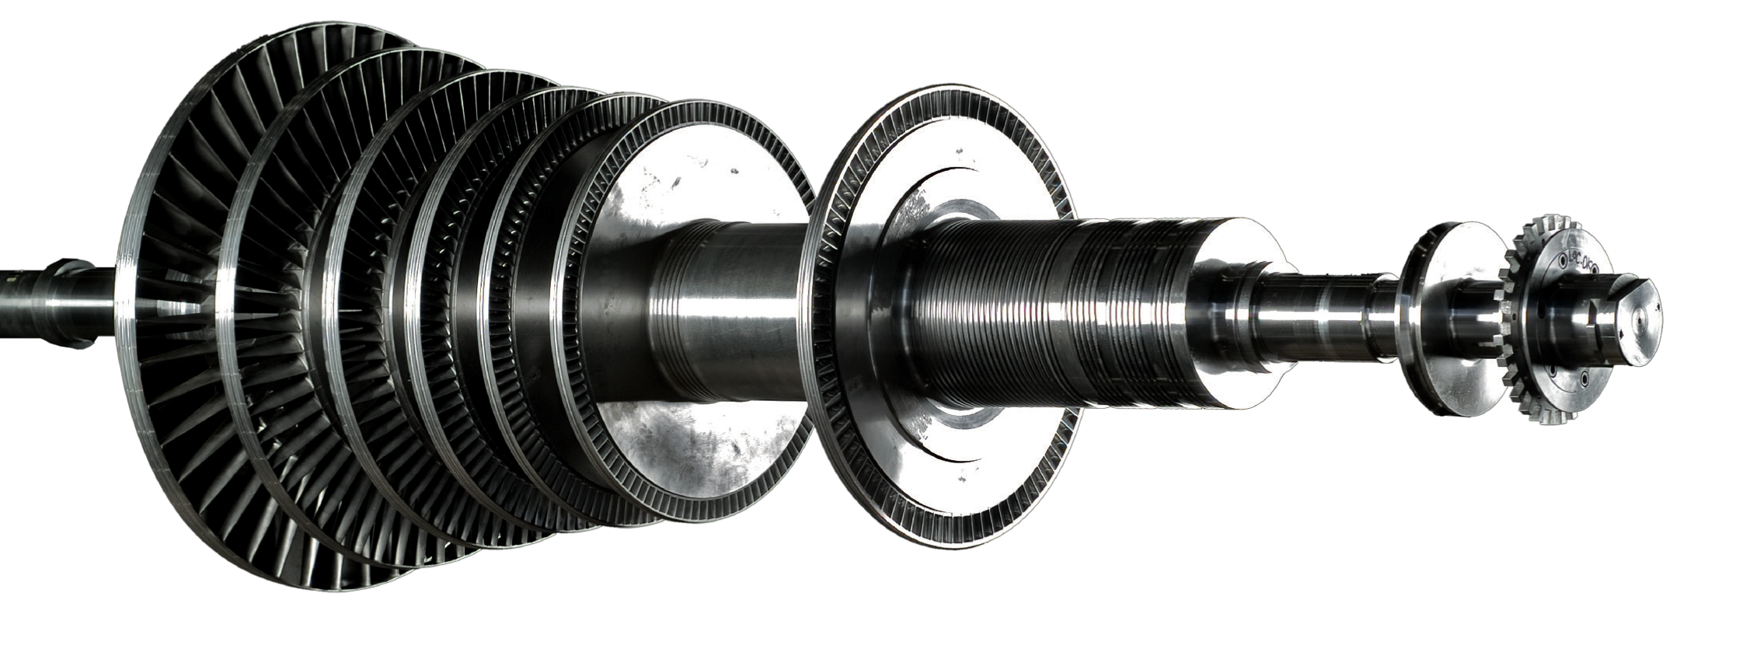
The Project
The following presentation illustrates the main technological solutions of a Steam Turbine designed and manufactured by Fincantieri S.p.A. to support a prototype for a Nuclear Micro Reactor Project.
infosteamturbines@fincantieri.it

Slide 3
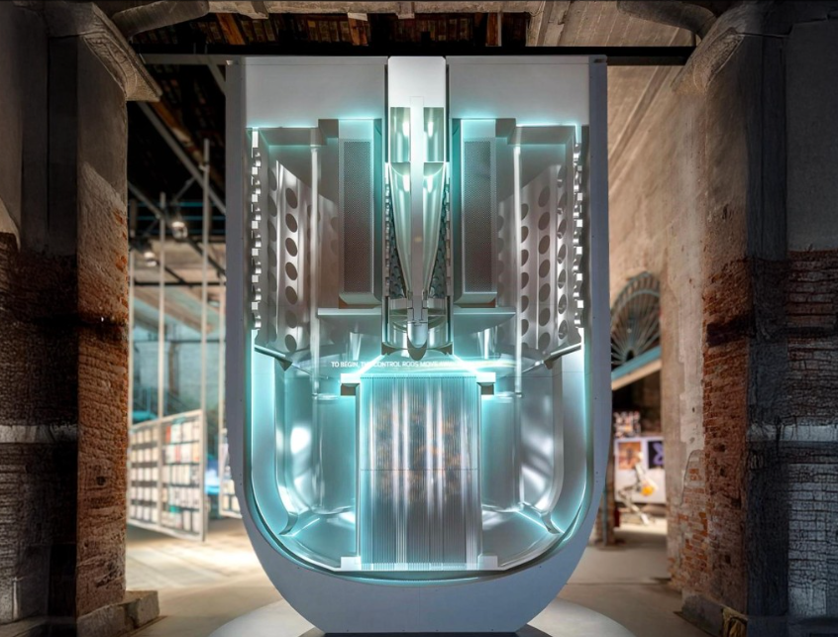
Steam turbines for Nuclear Application
In January 2025, Fincantieri signed a contract with Newcleo for the supply of a turbogenerator for PRECURSOR, a 10 MW non-nuclear integral-effect test facility, representative in size, complexity, and thermal-hydraulic performance of their Lead-cooled Fast Reactor (LFR).
PRECURSOR is under construction at the ENEA-Brasimone research centre, and it's a key milestone in the pathway towards the realisation of Gen-IV nuclear power plants.
infosteamturbines@fincantieri.it

Slide 4
Considered factors for the best technological choice
The design of the most suitable turbine was made taking into account many technical factors of the project.
Technical Factor Impact in the Turbine Design
High Temperature
High Pressure
Big Enthalpic Drop
Prototype Nuclear Application
Good Reliability
High Efficiency
High Availability
Casing Material
Seals Material
Taylored Steam Channes
Partial Arc Admission in the early stages
Number of stages
Special Starting procedure
Special Conical-Shape Turbine
infosteamturbines@fincantieri.it

Slide 5
Nuclear application
The most common nuclear power plants have been developed for heavy-duty, large-scale power generation.
Std steam quality: Saturated steam or with minimum degree of superheated steam
Very high steam flow
Power production greater than 1TWe for each power plant
Biggest multibody steam turbine has been developed for this type of application
New generation of nuclear power plant
New or different technologies may require modifications or specific designs of conventional parts.
Fincantieri is able to provide support and share its expertise in steam turbine design for the Micro Reactor Prototype.
Fincantieri is working on:
Modular design
Heavy steam conditions
Compactness and weight
infosteamturbines@fincantieri.it

Slide 6
Process Base Design
Fincantieri has also developed the process design for the 'conventional' part of the plant in certain projects, applicable to both land-based and on-board installations.
Each study has required a specific analysis to achieve the project’s objectives.
The project acquired from Newcleo in 2025 is a pilot plant for an LFR, with an output power limited to a few MWe.
For this project, Fincantieri also developed the base design of the “conventional” part of the plant, with the main objectives focused on:
Developing specific solutions for start-up, shut-down, and other transient situations to guarantee the minimum feedwater temperature of 327°C as required.
Designing a high-temperature range for the prototype solution, from 365°C up to 510°C.
Validating plant operation under all possible conditions.
In other projects, the effort required the development of specific solutions for:
Exhaust humidity control.
Weight and dimensions, with a focus on on-board applications.
Efficiency, targeting up to 40% for a 30 MWe project.
infosteamturbines@fincantieri.it

Slide 7
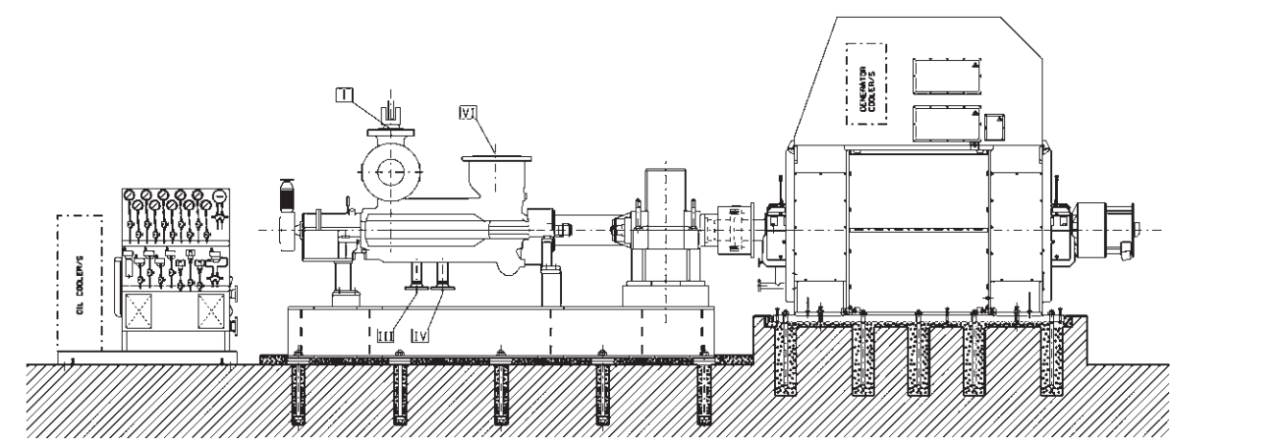
Base Design – Turbine
During the base design activities of a new technology, many different aspects of the ‘conventional’ side of the plant must be investigated and adapted to the reactor configuration and requirements. The first application, as a prototype, must be capable of operating in multiple configurations and withstanding several tests. The steam turbine design will be significantly influenced by:
Thermal stress
High inlet temperature range: from +40°C to +170° C respect saturation temperature
Frequent start-stop
Dedicated procedure for humidity control on exhaust
Dedicated design and material for each turbine sections
infosteamturbines@fincantieri.it

Slide 8
Turbine Design
Fincantieri invests every year in turbine design to guarantee the best product and to continuously improve its technology.
The Fincantieri steam turbine is entirely designed in-house, without any external collaboration.
Fincantieri is able to adapt its turbine design to specific requirements, thanks to its full range of capabilities and expertise, and routinely customizes designs to meet customer needs through a tailor-made approach.
Design and Engineering
The company’s capabilities and expertise cover structural, thermodynamic, and fluid dynamic design and analysis, supported by specialized engineering software tools, both commercial and developed in-house.
Production and manufacturing technology
The company’s expertise spans structural, thermodynamic, and fluid dynamic design and analysis, supported by specialized engineering software tools—both commercial and in-house developed.
infosteamturbines@fincantieri.it

Slide 9
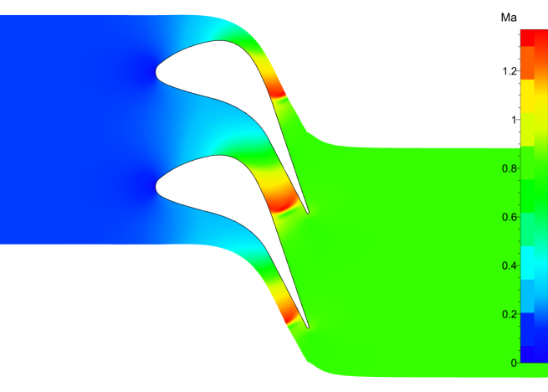
Turbine Design
Fluid dynamic analysis
Fincantieri develops its own aerodynamic blade profiles for subsonic, transonic, and supersonic flow regimes.
The figures show examples of an unstructured grid approach for blade analysis using a commercial software tool.
Rotor dynamics analysis
Turbine rotors are analyzed to assess lateral and torsional critical speeds and to ensure adequate separation margins, using appropriate modeling of bearings and rotor geometry, along with suitable lumped masses and inertia to represent the effects of the blading.
Mach 0.8
infosteamturbines@fincantieri.it

Slide 10
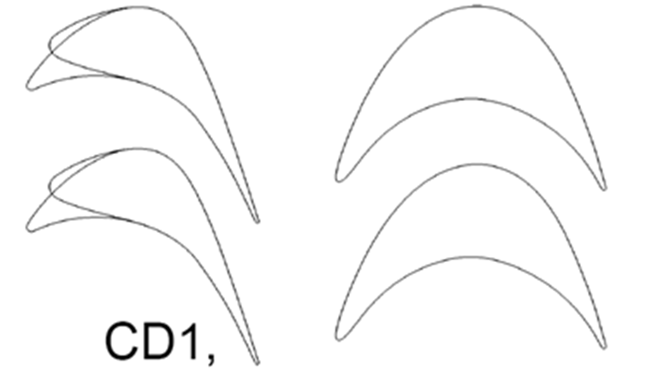

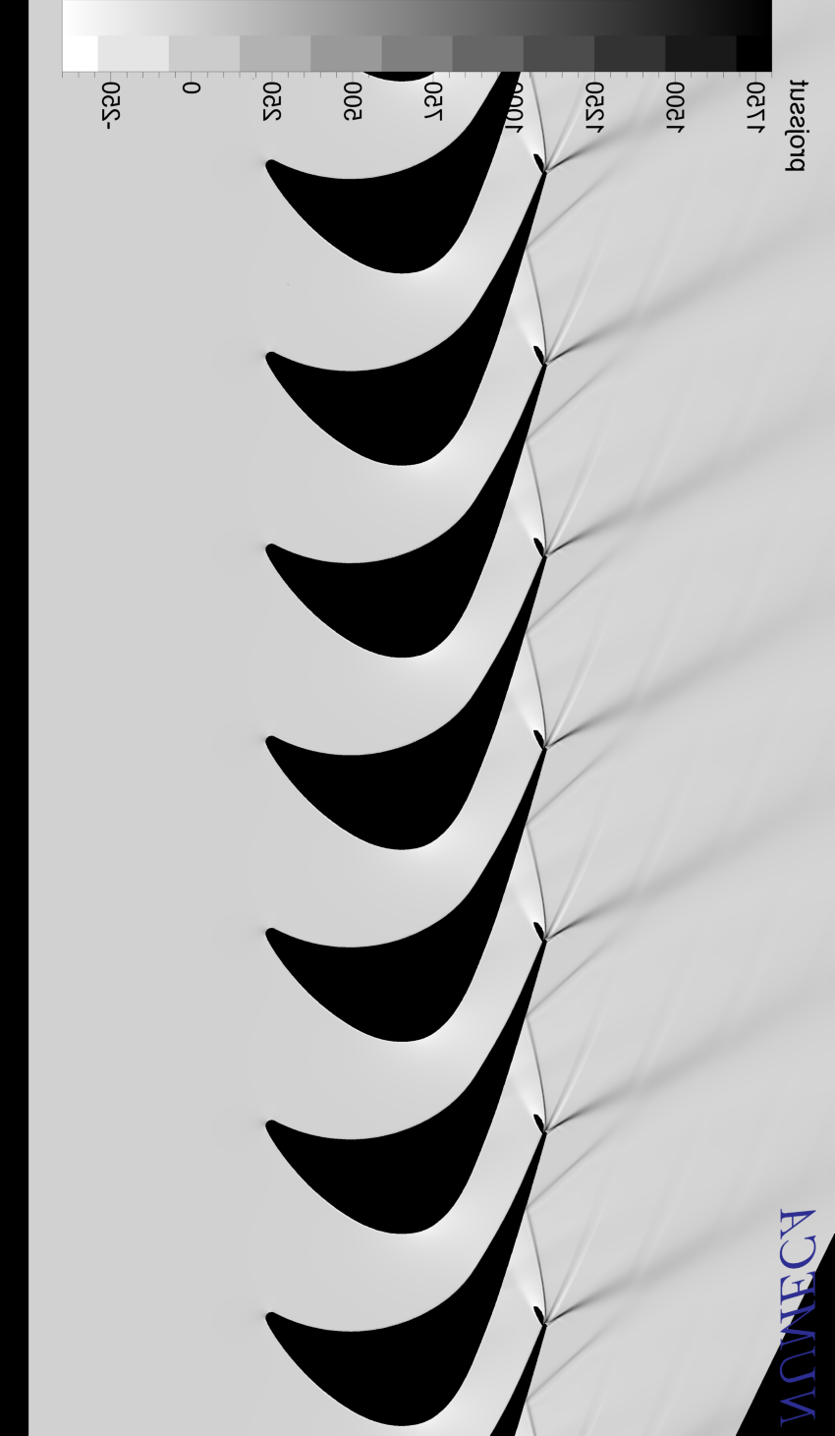
Experimental Tests
Numerical design and analysis require validation through testing. While many test cases are available in the literature, in some instances dedicated experimental tests are carried out in collaboration with universities.
Aerodynamic Sperimetal Research
Collaboration with University test Bench POLIMI (Milan) and UNIGE
New Supersonic Profile Families
Experimental Validation
of Numerical Design
Experimental and Numerical Comparison
Experimental Output
Numerical Output
infosteamturbines@fincantieri.it

Slide 11
Considered Range of Temperatures for Different Applications
To meet the demanding operating conditions of the project, the turbine will be custom-engineered for high pressure and temperature performance.
Turbine Appliction
Waste to Energy
Biomass
Oil&Gas
Maritime
Sugar Plants
Nuclear
Max. Temperature Max. Pressure
Saturated Steam 530 °C
20 Bara 140 Bara

Slide 12
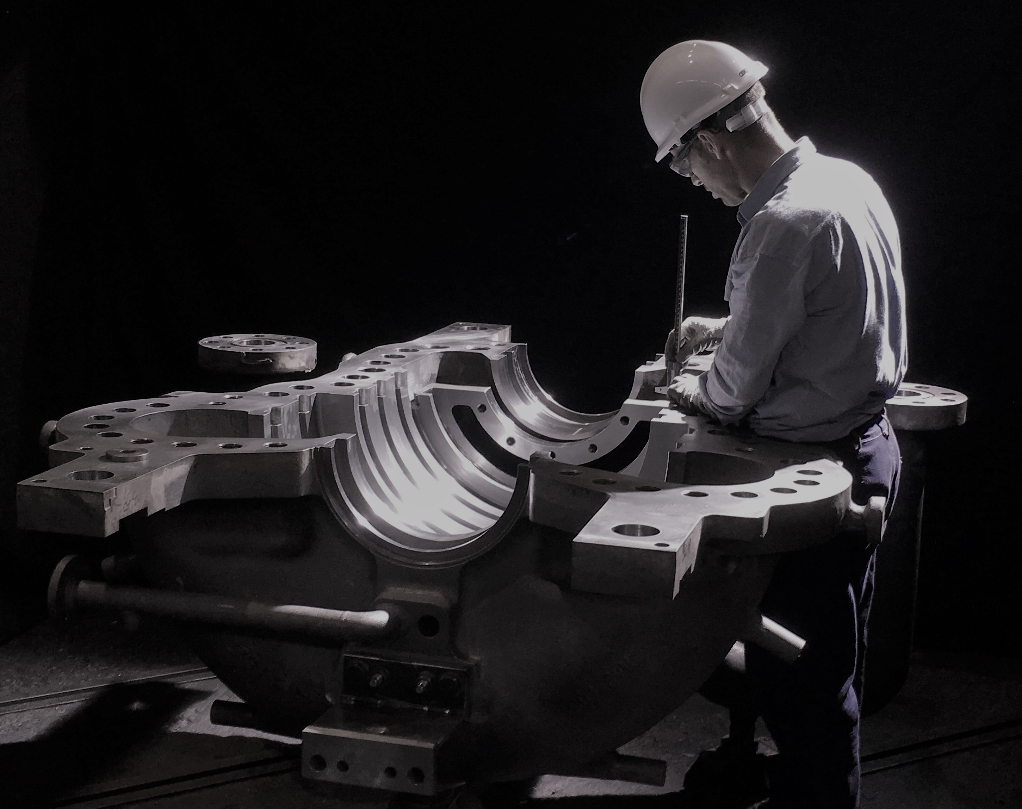
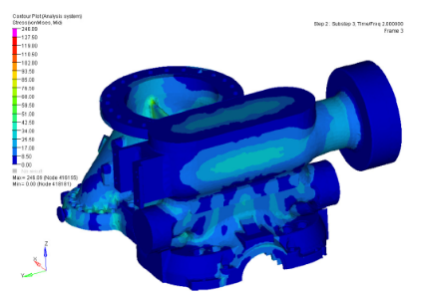
Selection of Casing Material
The selection of the casing material was driven by the need to ensure reliable performance under high temperature and pressure, as required by the demanding steam conditions typical of nuclear applications.
infosteamturbines@fincantieri.it

Slide 13
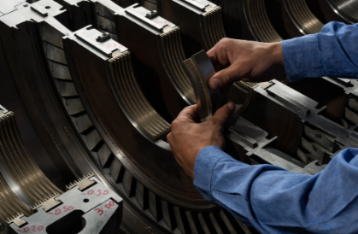
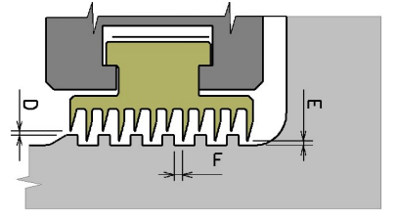
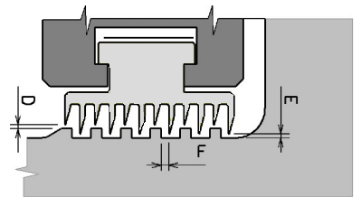
Steam Steals material Selection
The choice of seal material was driven by the need to ensure durability and optimal performance under elevated steam temperatures and pressures, minimizing seal wear to reduce aging effects.
Bronze Seals
Stainless Steel Seals
infosteamturbines@fincantieri.it

Slide 14
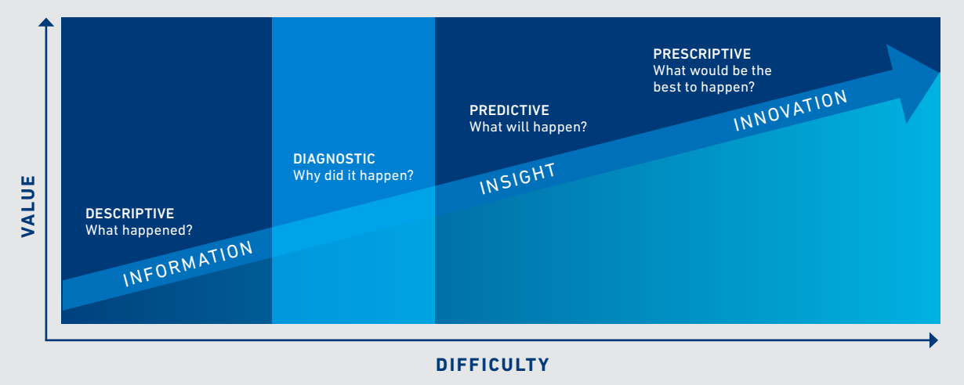
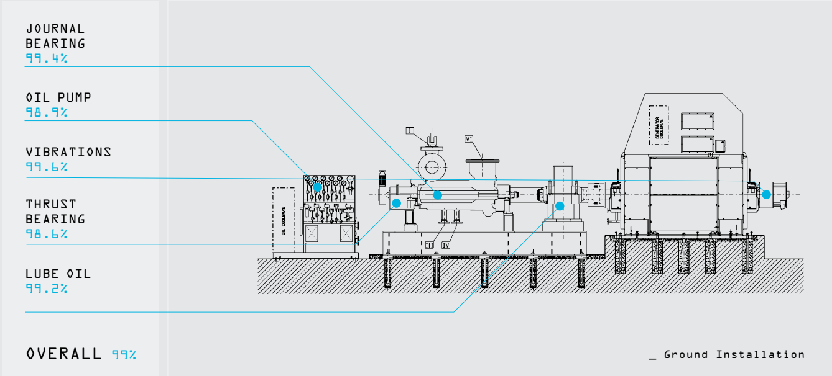
Customized Remote Monitoring Service
The characterization of the turbine for use as a prototype also influenced the design of a specific remote monitoring system, capable of monitoring and predicting the turbine’s behavior under particular operating conditions.
infosteamturbines@fincantieri.it

Slide 15

Conclusions
Fincantieri has developed a highly efficient, customized multistage steam turbine for Newcleo’s PRECURSOR project, a 10 MW non-nuclear integral-effect test facility, supporting fourth-generation nuclear technologies.
This solution combines outstanding performance, sustainability, and reliability, marking a key step toward a safer, more sustainable energy future.
This collaboration reinforces Fincantieri’s role as a leading technological partner in advanced energy sectors.
infosteamturbines@fincantieri.it

Slide 16
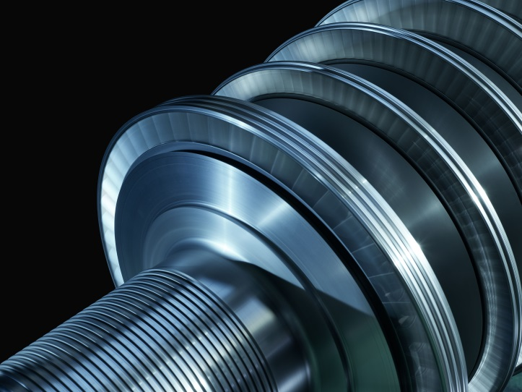
Thanks for your attention !!!
For any questions please refer to:
infosteamturbines@fincantieri.it

