Slide 1
The size of the SMRs to compensate for the volatility of renewables in the Romanian energy system
Ionut PURICA
Prof.Dr.ing.Dr.ec.c.m.AOSR

Slide 2
EU Green Deal
Comunism ended because it did not internalized the cost of capital; Capitalism may end because it does not internalize the cost of environment
The Green Deal aims at diminishing the costs to the environment by making the EU economy emission neutral at the horizon of 2050.
Action lines:
Energy
Transport
Buildings
Innovation

Slide 3
Energy
Case ROMANIA

Slide 4
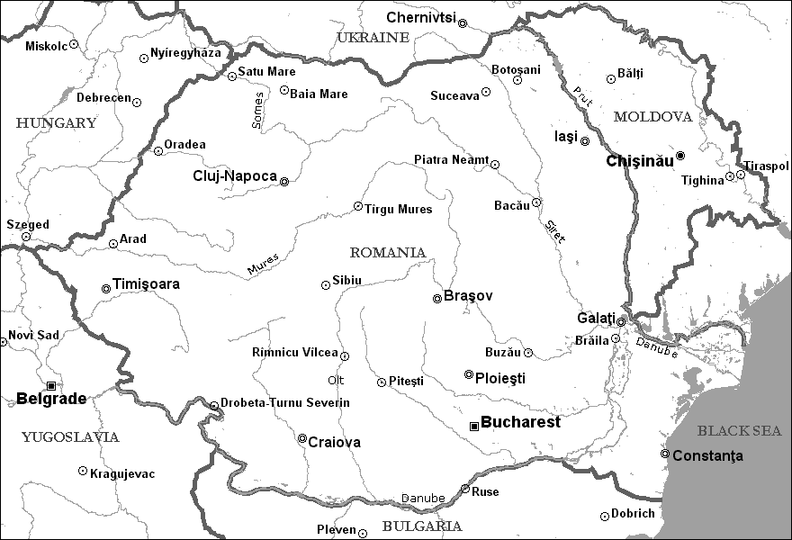
Cluj
Bistriţa
Sebeş
Haţeg
Targu Jiu
Curtea de Argeş
Buzău
Caransebeş
Ramnicu Vâlcea
Porţile de Fier
Map 1: Hidroelectrica hydro power plants

Slide 5
Suceava
Oradea I
Iasi
Bacău
Oradea II
Iaşa II
Borzeşti Term
Borzeşti Con
Iernut
Arad
Mintia
Braşov
Paroşeni
Galaţi
Doiceşti
Brăila
Rovinari
Turceni
Piteşti Sud
Brazi
Isalniţa
Grozăveşti
Craiova
Bucureşti Vest
Bucureşti Sud
Palas
Progresul
Map 2: Termoelectrica thermal power plants

Slide 6
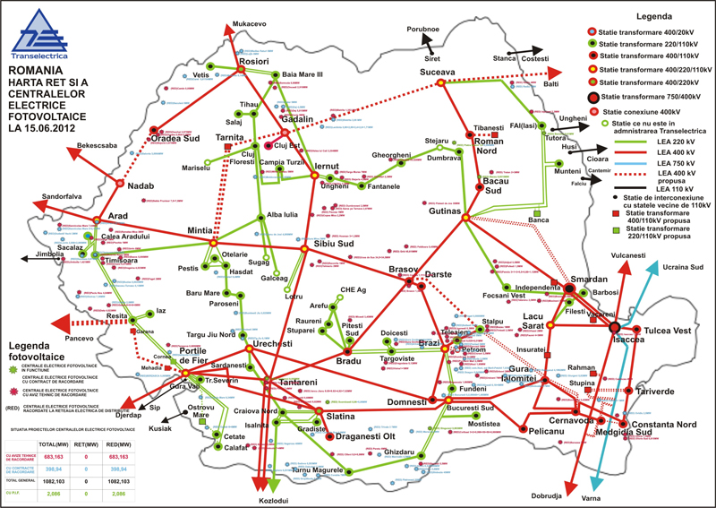

Slide 7
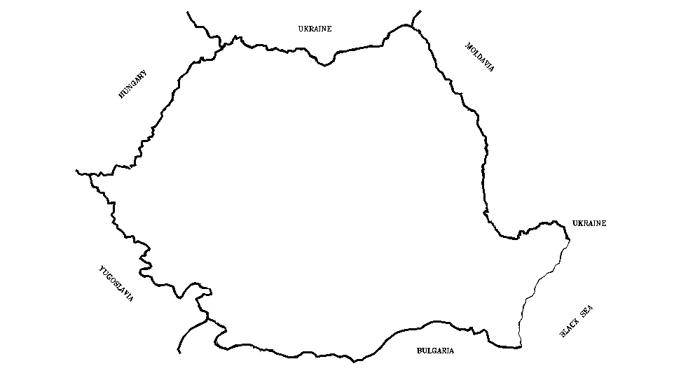
Mukacevo 0.0
110kV
Costesit 85.0
220kV
Rosiori 0.0
400kV
Stinca 0.0
Ungheni 91.0
750kV
Tutora 0.0
Cioara 80.0
Husi 0.0
Sandorfalva 1.0
Arad 0.0
Jimbolia 0.0
Kikinda 0.0
South Ukraine 0.0
Portile de Fier 459.0
Isaccea 0.0
Gura Vali 0.0
Djerdap 741.0
Ostruvu Mare 0.0
Isaccea 0.0
Sip 20.0
Tinteri 316.0
Insalnita 0.0
Kusijak 0.0
Kozlodui 451.0
Vama 0.0
Kozlodui 0.0
Map 5: Electricity exchanges across interconnections, 2000 (GWh)

Slide 8
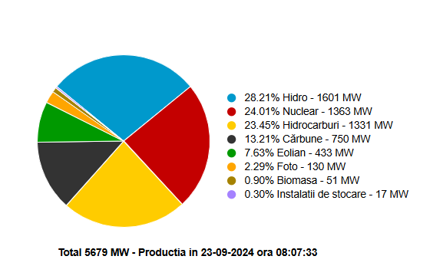
Romania power system production

Slide 9
Elements of security
According to the Security strategy of the energy systems launched by the EU Commission in 2014 it is necessary to have a diversified portfolio of electrical energy generation technologies that ensures the coverage of situations when various types of risks manifest themselves. The same applies for gas interconnectors and for the climate change risks impact on critical infrastructures.

Slide 10
The standard deviation of each volatile source is giving the size of the needed reserve of power for the system.
The probability distribution are based on real data over sizeable time intervals. For instance for the Danube flow the data period is 1845-2006.
For the climate change risks the data period is 1961-2011.
For Italy the gas grid risk map is based on earthquake and land slide and mechanical risk, while for Romania it is based on the climate change risks and mechanical risk.

Slide 11

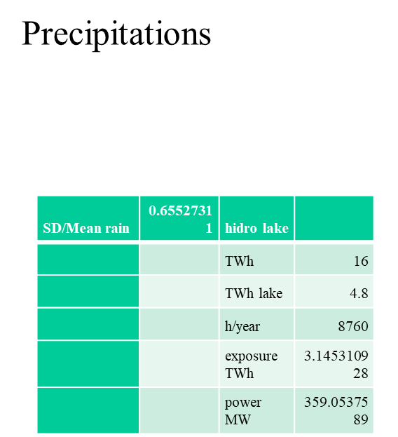
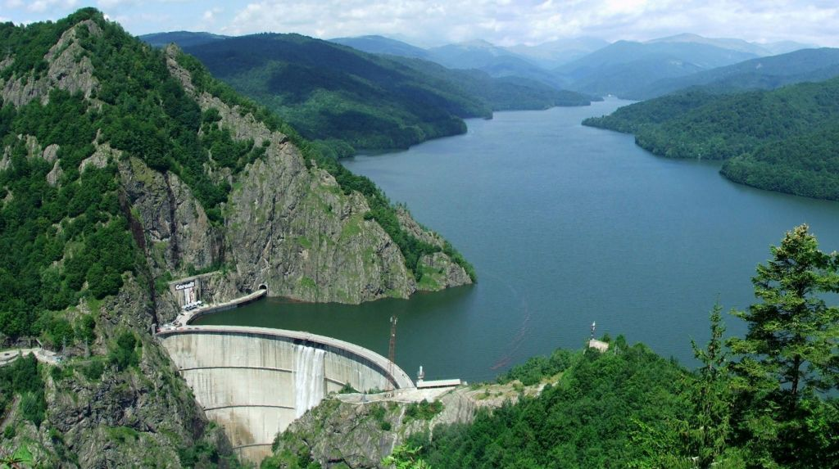

Slide 12
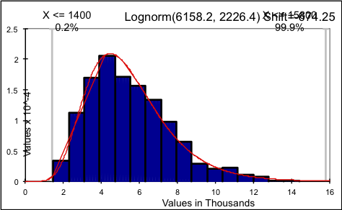
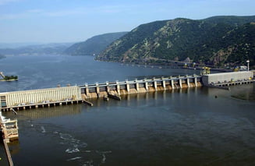
Danube
SD/Mean Danube | 0.361534215
 |  | Needed security hydro run river
 |  | TWh | 16
 |  | TWh run river | 11.2
 |  | h/year | 8760
 |  | exposure TWh | 4.049183203
 |  | power MW | 462.2355254

Slide 13
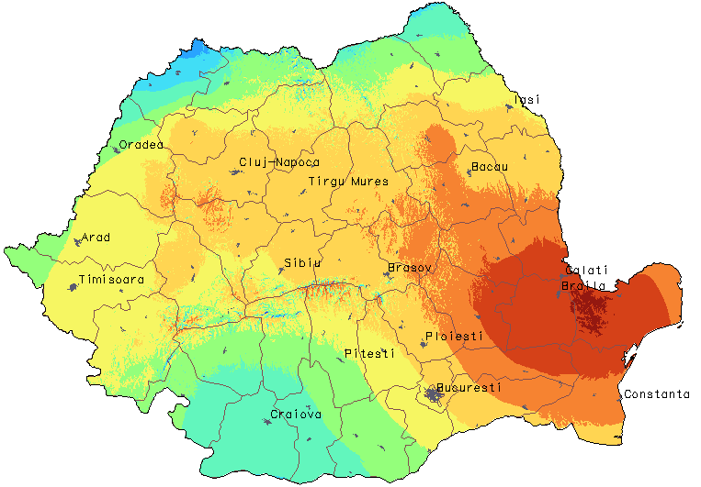
Wind
SD/Mean wind | 0.5 | wind
 |  | TWh | 3
 |  | TWh wind | 3
 |  | h/year | 8760
 |  | exposure TWh | 1.5
 |  | power MW | 171.2328767

Slide 14
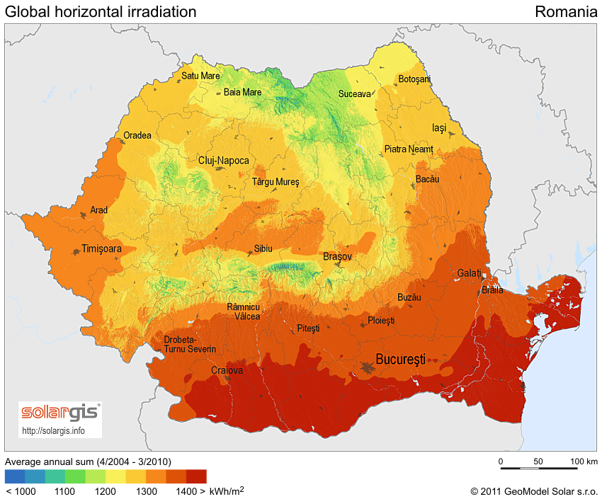
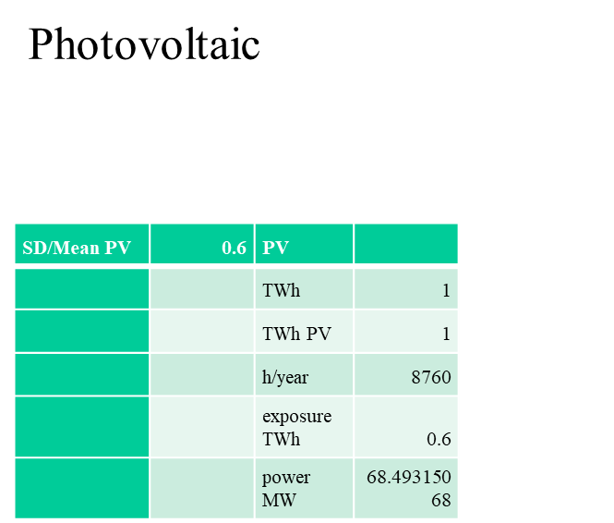

Slide 15
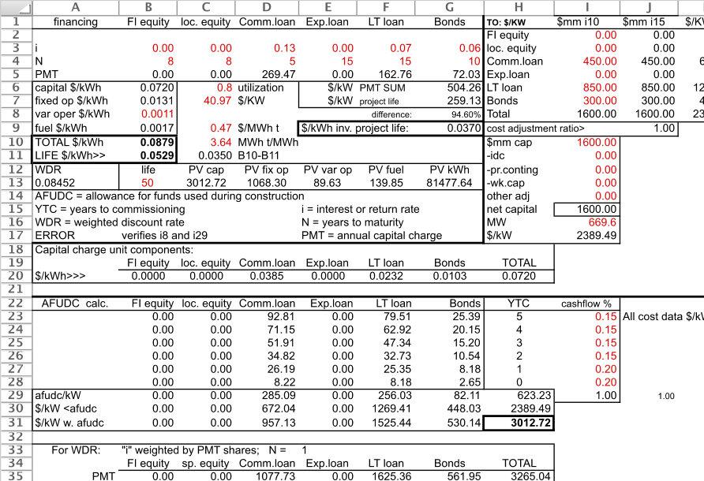
In the table below a simulation of a typical financing scheme is presented for a coal power plant of 669 MW having a total of 3000 US$/kW and a lifetime of 50 years (the monetary units in the table are given in US$ but they can be replaced with Euro without changing the values).

Slide 16
Climate change risk
Big data analysis needed
Potential Insurance policy

Slide 17
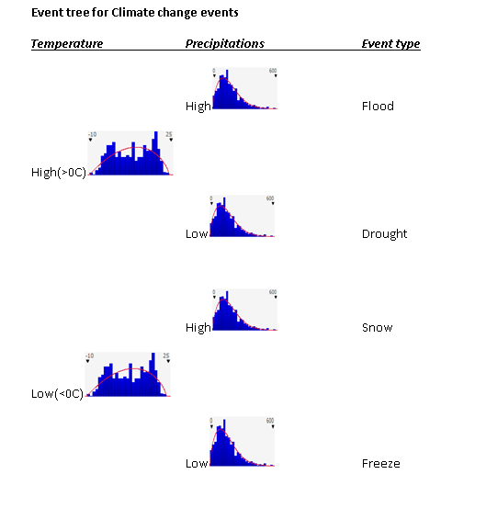
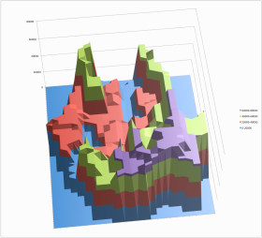
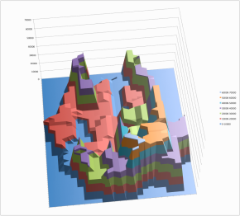
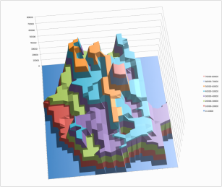
Risk maps

Slide 18
Total CC events risk map [thousands US$]
distribution of risk premium per capita

Slide 19
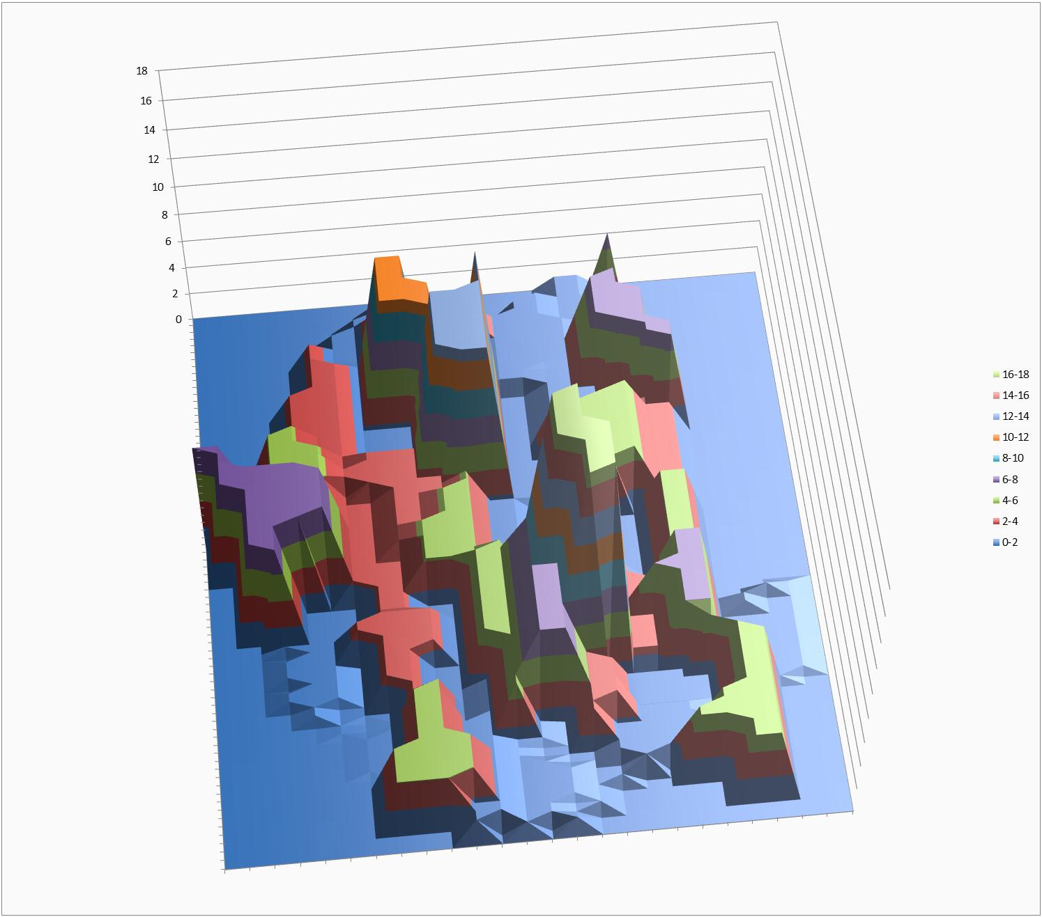
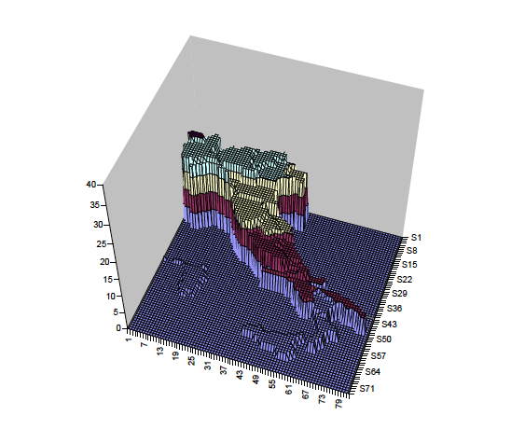
Romania gas grid CC and mechanical risk [probable deaths/1000 cap]
Natural gas risk in Italy
[probable deaths / million inhabitants]

Slide 20
Forecasting and planning
Models for the energy system penetration of new technologies
Optimize for emissions reduction

Slide 21
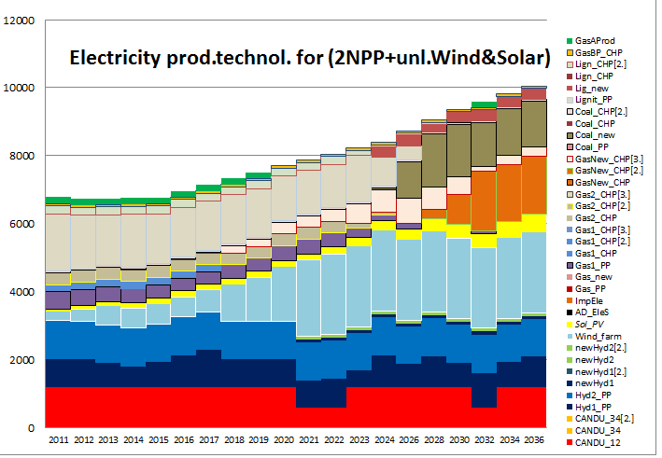
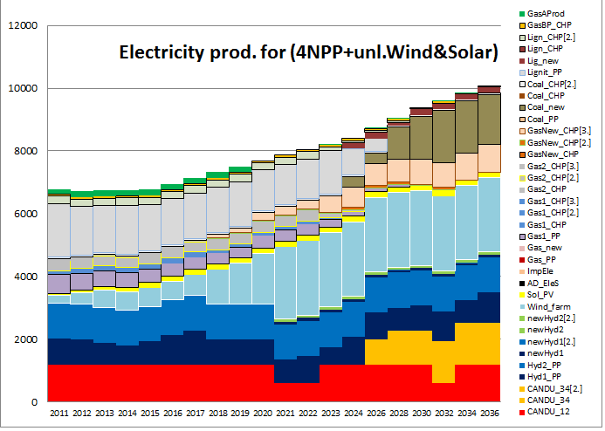
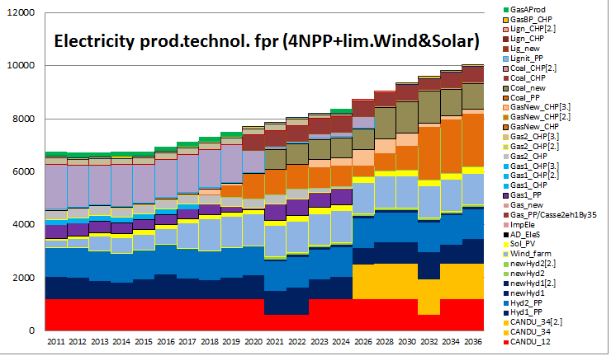
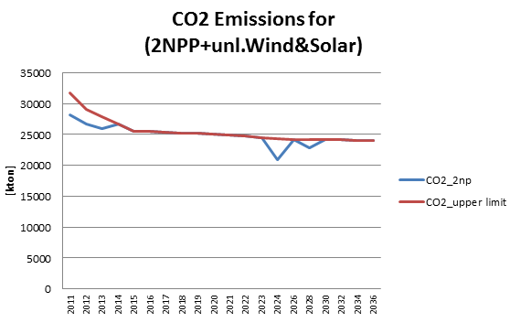
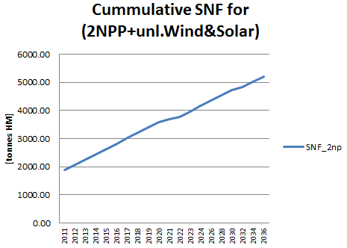
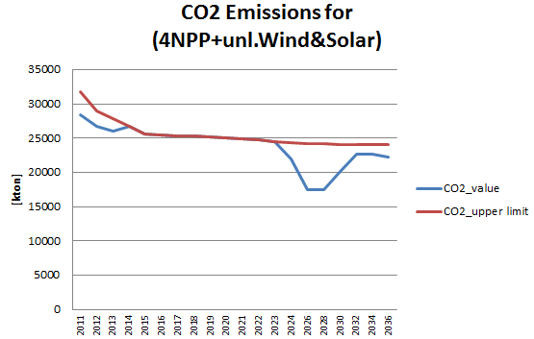
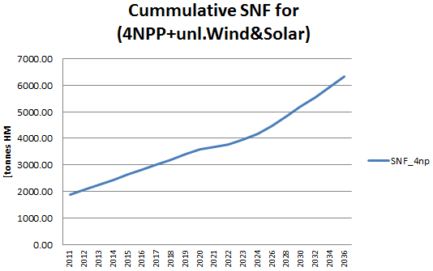
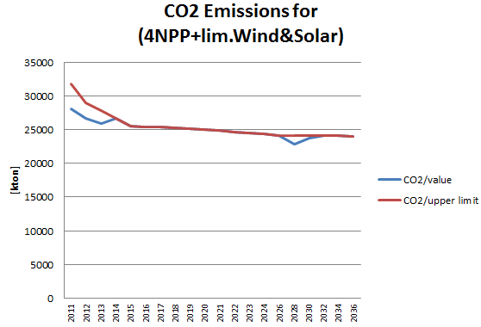
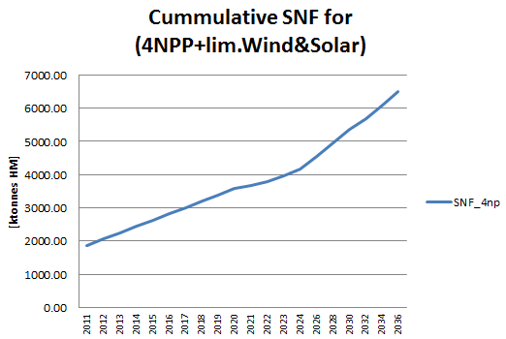
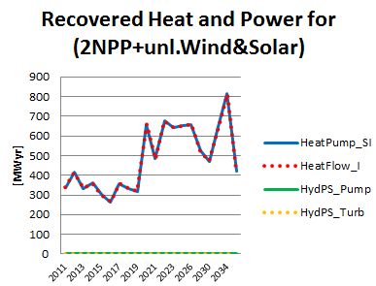
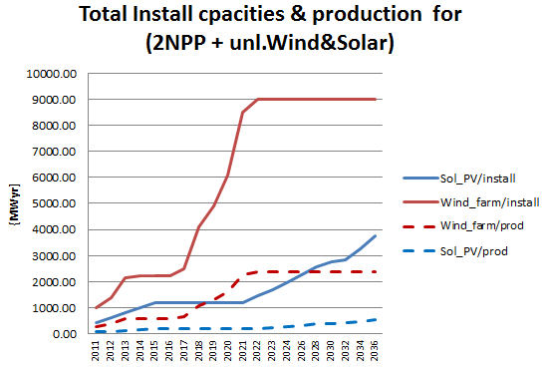
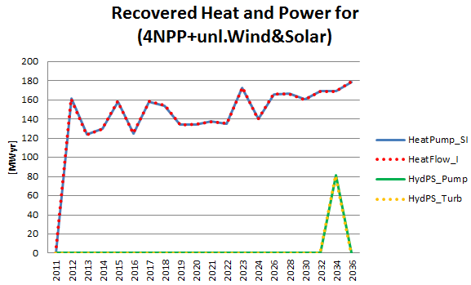
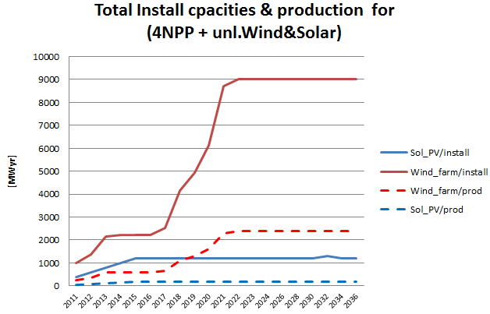
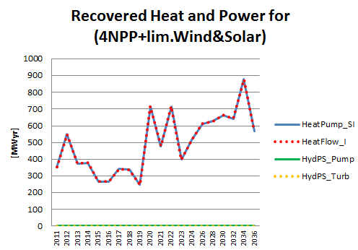
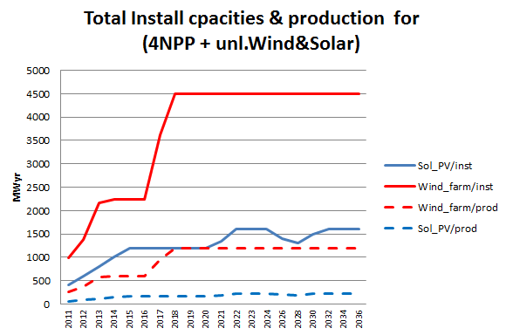
ACTING FOR THE NEAR FUTURE MESSAGE results for 3 Scenarios for Nuclear/Renewable ratio in the NEMix until 2035
Goal: Select the optimal Nuclear/Renewable ratio in the NEMix until 2035 for D2,d2,p10
21

Slide 22
Large power emission free technology
New small modular reactors
Will fusion be in time ?

Slide 23
Conclusions
the results of evaluating the mitigation and adaptation measures to the risks in the energy system (considering only hydraulicity, wind and photovoltaic) lead to the need of coal capacities of at least 1000 MW, that Romania has now.
Security to the system may be enhanced by SMR technology penetration at a size estimated above. That can replace the coal fired technology existing today, in about 10 years.
The energy sector may not be regarded from only a commercial view point, its strategic importance as well as the social one make necessary taking into consideration noncommercial costs that must be internalized in the financing scheme to reach optimal decisions.

Slide 24
THANK YOU
puricai@yahoo.com
+40745167781

