Slide 1
The content of this Presentation is confidential and protected under the relevant Intellectual Property laws. The Presentation may be used only in consideration of the Purpose of the Presentation. This Presentation may not be disclosed, copied, referred to or quoted, in whole or in part, to any other person without RoPower Nuclear prior written consent, and then only on the basis that it is confidential. We accept no liability to any person in relation to this Presentation, even in case of approved disclosure. All sections of this Presentation are to be read in conjunction with the other sections of the Presentation and form a single integrated document.

Slide 2
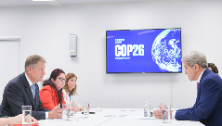
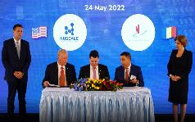
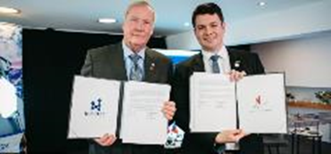
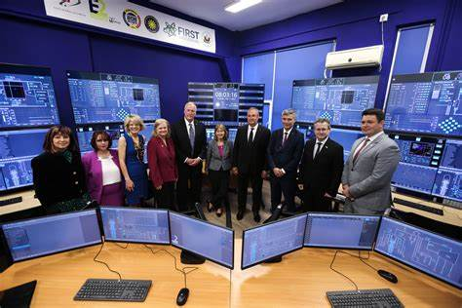
Project Background (1)
Nov ’21: President Klaus Iohannis and US Special Presidential Envoy for Climate, John Kerry, announce to build Europe’s first Small Modular Reactor at COP 26 Glasgow; SNN-NuScale Teaming Agreement signed
May ’22: Doicesti location announced
Jun ’22: President Biden announces USG $14m grant for Romania project
Aug ’22: IAEA mission successfully audits site selection financed through a $1.2m USTDA grant and final positive clearance issued April 2024
Oct ’22: USTDA grants $14m for FEED Phase 1 contract
May ’23: The launch of E2 Center, the first simulator of NuScale SMR control room
DFC letter of interest amounting to $1bln & letter of interest US Exim amounting to $3bln
May ’23: U.S. and multinational public-private partners look to finance up to $275 million for the Small Modular Reactor (SMR) project in Romania US EXIM and FDC issue Letters of Interest for $4 billion financing
June ’23: Nuclearelectrica, NuScale Power, E-INFRA, Nova Power & Gas, Fluor Enterprises and Samsung C&T Corporation sign a Memorandum of Understanding for the project development
July ’23: DS Private Equity (“DSPE”) signed the Term sheet Agreement with Nuclearelectrica and Nova Power & Gas with the intention to invest 75 million Euro in the project.
July ’24: Approval of the increase of the loan granted by SNN (as lender) to RoPower (as borrower), up to the amount of USD 243,000,000
October ’24: US Exim’s Board approval of a final commitment for a $98 million loan under EXIM’s Engineering Multiplier Program for RoPower Nuclear S.A.

Slide 3
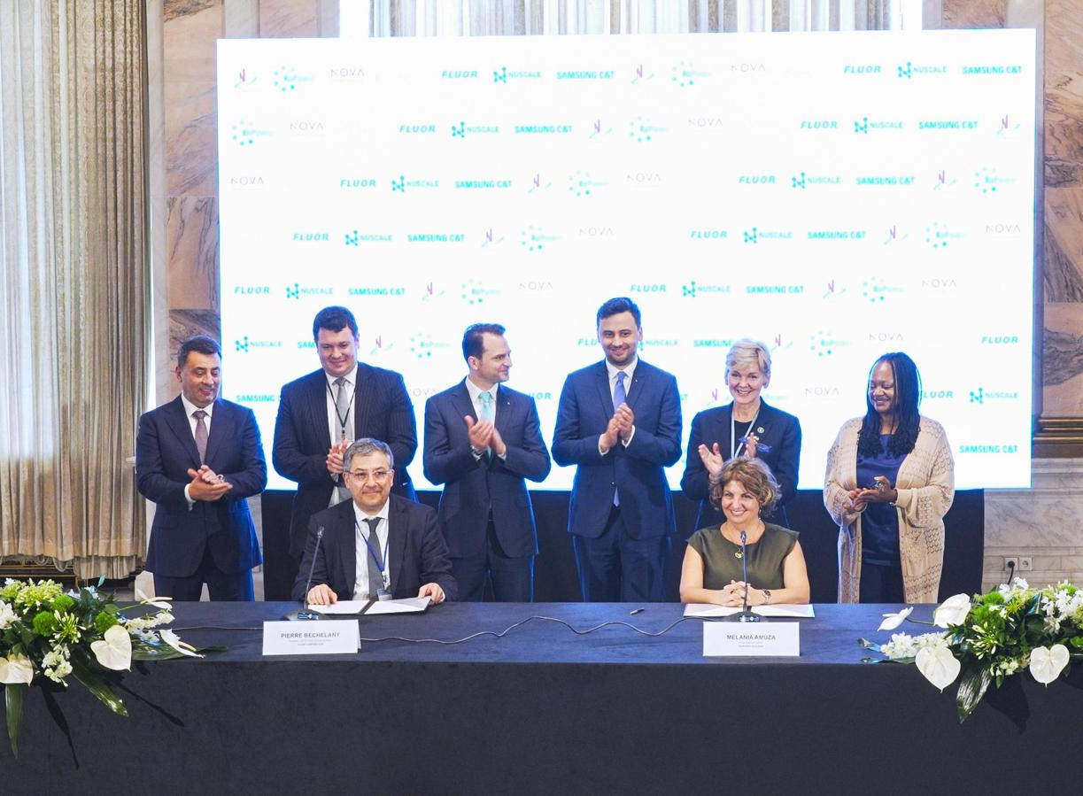
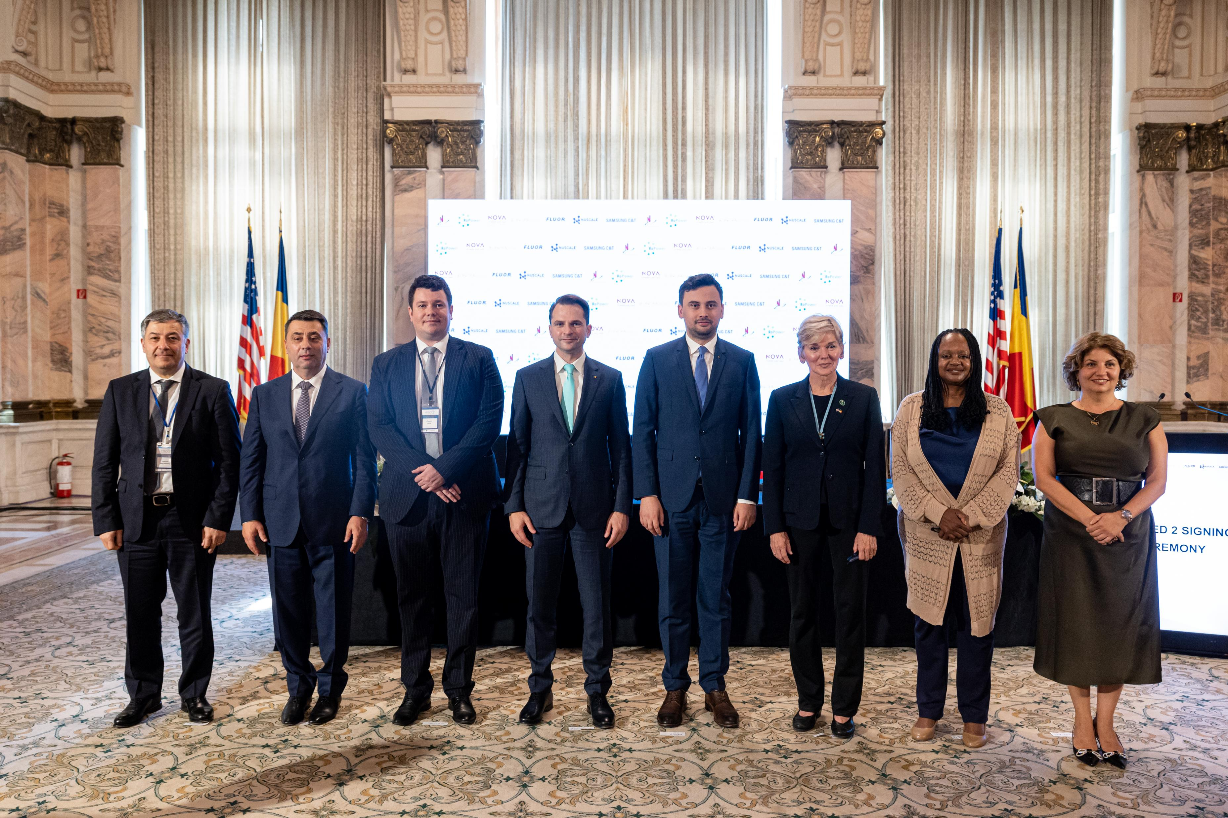
Project Background(2)
May 11th site visit
July 2024 SN Nuclearelectrica and RoPower Nuclear announce the signing of the Front-End Engineering and Design (FEED) 2 contract with Fluor Corporation. The signing ceremony took place during the Partnership for Transatlantic Energy and Climate Cooperation (P-TECC) summit and marks a significant milestone in Romania's advancement of clean energy technologies.

Slide 4
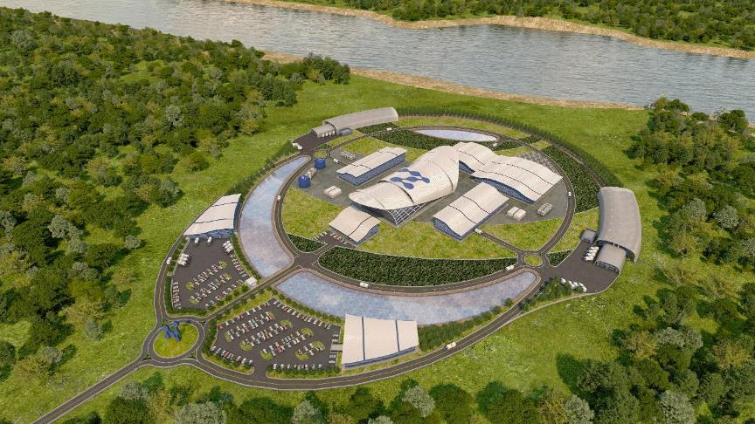
Key Project Figures (1)
NuScale SMR is the first small modular reactor design approved by the U.S. Nuclear Regulatory Commission (NRC), since August of 2020.
The implementation in Romania will be compliant with the Romanian and European legislation, in preparation for both localization of scope in the country, but also undertaking all proceedings to develop into regional hub

Slide 5
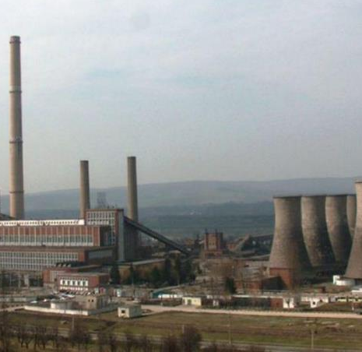
SMR Project in Romania is developed on a former coal plant Doicesti: A Former 520MWe coal-fired PP Coal to Nuclear
Key Project Figures (2)

Slide 6
Key Project Figures (3)
Transforming Energy in Romania
462MWe installed capacity, consisting of 6 x 77MWe NuScale Power Modules (NPMs)
Option to use solar capacities, development by E-INFRA, to prove the renewable-nuclear complementarity
Social Impact
200 permanent jobs
1500 jobs during construction
2300 jobs in manufacturing
4 mil. tons of CO2 avoided every year

Slide 7
Project Evolution – what has been done?
USTDA Grant & Feasibility Study
A USTDA-funded study, led by Sargent and Lundy evaluated 25 potential sites and assessed 4 SMR technology vendors
Ranking & Selection
A comprehensive ranking process was conducted, analyzing safety, infrastructure, grid connection, environmental and socio-economic factors
Preferred Site and Vendor
IAEA SEED Mission
Following this evaluation, Doicesti was selected as the most suitable candidate site and NuScale Power was identified as the preferred technology partner
IAEA carried out a SEED (Site and External Events Design) mission, validating site suitability and confirming alignment with international safety standards.
Integration into Nuclear Strategy
SMR technology has been incorporated into the National Energy Strategy, not only as a stated intention, but as a defined component of its strategic objectives.
May 11th site visit

Slide 8
Project Evolution – what will follow next ?
European & Global Alignment
RoPower actively supports initiatives under Nucleaeurope and the European Commission SMR agenda, ensuring Romania’s leadership role within EU nuclear policy
Synergies with Other Projects
The SMR program is being correlated with other strategic projects, such as ALFRED (lead-cooled fast reactor demonstration) and the continued development of Cernavoda Units, ensuring complementarity and knowledge transfer
Regulatory process
Licensing work has officially started. Applications for design review and ISAR have been submitted, representing the first concrete steps toward regulatory approval
May 11th site visit

Slide 9
Project Evolution - phases
Phase 1 - FEED Phase 1 – Completed
Phase 2 - FEED Phase 2 ONGOING 14 months starting September 2024
Phase 3 Engineering, Initial Procurement Phase, Site Preparation
Phase 4 - Construction
Phase 5 - Commissioning
Phase 6 - Commercial Operation

Slide 10
FEED Phase 1 – Lessons Learned
Accomplishments
Successfully completed site-specific design adaptation, proving that Doicești is a viable site for SMR deployment.
Strengthened alignment with Romanian, European, and U.S. regulatory requirements.
Identified synergies with renewable integration and national grid modernization.
Key Lessons
Licensing Complexity: Early engagement with regulators revealed the need for more detailed local safety case adaptation. → Action: Expanded cooperation with CNCAN (Romanian regulator) and IAEA to streamline approvals.
Supply Chain Gaps: Mapping showed areas where Romanian industry needs targeted investment (e.g., nuclear-grade manufacturing, cybersecurity, etc). → Action: Training programs and partnerships with local companies launched.
Community Engagement: Initial consultations highlighted public curiosity but also the need for more proactive communication on safety and socio-economic benefits. → Action: Enhanced outreach and educational initiatives in Doicești and beyond.
Integration Challenges: Combining nuclear baseload with renewables requires advanced digital control and grid balancing. → Action: Collaboration with E-INFRA to test hybrid system operations early.

Slide 11
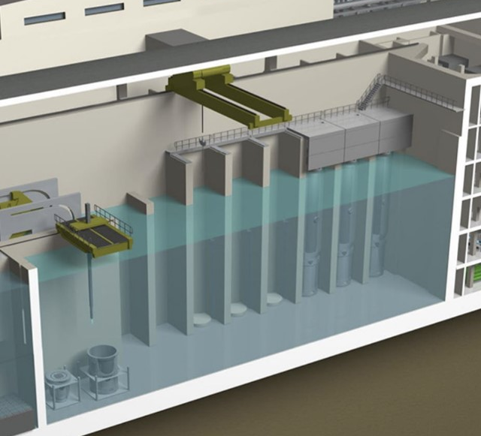
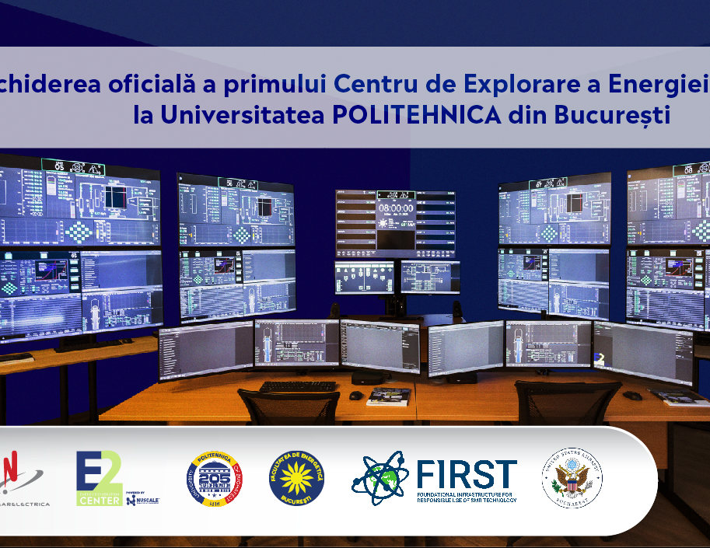
Project Background
Long-Term Vision
Romania has the potential to accommodate the first deployment of SMRs in Europe and become:
An expert in coal to nuclear transition
A catalyst for SMRs in the region
Integral part of an European and Global SMR supply chain
Nationally, regionally / internationally, for:
Non-Nuclear equipment for NPP (SG, Turbines, generators, diesels, I&C, electrical equipment, remote surveillance etc.)
A base for production and assembly of components
Nuclear Fuel manufacturing and Life Cycle management
Nuclear Project management and Construction expertise
Nuclear Supply Chain oversight expertise
Others: Cybersecurity, security expertise
An Expert center for Nuclear Safety Cases for SMR’s
A hub for expert training and operations (S. N. Nuclearelectrica)
A hub for maintenance and refueling

Slide 12
Why Romania?
28 years of safe nuclear plants operations for S.N. Nuclearelectrica
More than 50 years of experienced rigorous Nuclear Industry Regulator (CNCAN)
More than 50 years of experienced Nuclear Industry supply chain
Public opinion and political support
Highly appreciated engineering education system
Active member and participant in IAEA/WENRA/INPO/WANO/OECD/EPRI

Slide 13
Why Romania?
The Doicesti SMR project proves that the end of coal can be the beginning of something greater — a cleaner, safer, and more prosperous energy future. Romania is not just building reactors; it is building confidence, expertise, and leadership for Europe and the world.

Slide 14
