Slide 1
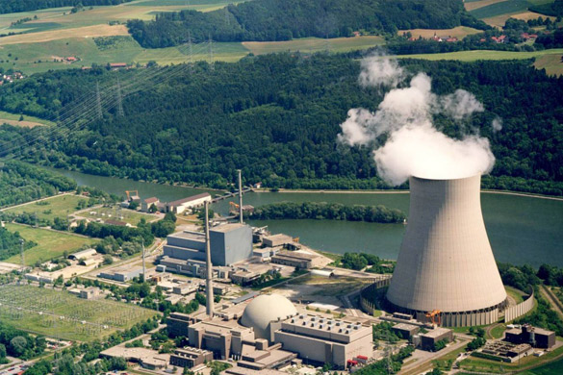
Polish Nuclear Energy 2025 New Perspectives and Challenges
Wojciech Dąbrowski CEO
think tank "Security Energy Technology"

Slide 2
Polish Nuclear Programme: Key Historical Milestones and Evolution
Early Nuclear energy Plans in Poland
for decades nuclear energy in Polandwas more theoretical than practical.
initial plans in 1970s focused on Żarnowiecbut were suspensded in 1990 due the political changes and public protests.
2014 Political Nuclear Energy Programme(PPEJ)
the first programmeaimed 6-9GW capacity by 2035 but faltered due to political indecision
Goverment Actions in 2022
-government approved Westinghouse technology for Lubiatowo-Kopalino.
-initially planned a Korean KHNP plant in Konin,which was later canceled.
2025 PPEJ Update
-the PPEJ update adopted in 2025 sets a clear financial, scheduling and technological framework.
-the updateis subbmitted now for public consultation.

Slide 3
Advancing Nuclear Initatives Beyond PPEJ and PPEJ 2025 Nuclear Expansion
Nuclear initatives underway outside PPEJ
-four nuclear initiatives by KGHM,Orlen,PGE PAK and Swietokrzyska Industrial
Group
-projects include both large plants and small modular reactors(SMR)
Roadmap and deployment plans for SMR's
-roadmap for SMR in Poland is planned,signalling regulatory progress.
-first SMR expected at Włocławek, two 300 MWe GE/Hitachi reactors planned at Anwil
factory
-targeted construction period 2028-2035.
PPEJ 2025 update nuclear plans
-planning two nuclear plants totaling 6-9 GW
-marks a significant shift toward nuclear energy in Poland's enregy mix

Slide 4
Lubiatowo-Kopalino Financing Structure: Comprehensive Cost Coverage
Public Funds
approx. 15 billion eur(30% cost),from the state budget to recapitalise PEJ.
Export Credits
-financial support from foreign
suppliers,covering up to 70% of
costs
Commercial Sources
-remaining funds sourced from
domestic and international banks
Deatiled Breakdown of Funding Sources and Financial Challenges

Slide 5
Risks and Challenges of Nuclear Energy in Poland
the European Commission will decide on state aid for Lubiatowo-Kopalino later this year.Poland's financing model based on a contract for difference,assuming 100% technical capacity(92.7% capacity factor), which is unrealistic.This affects the agreed electricity price range of approx.120 eur MWh under the contract for difference, guaranteeing PEJ a fixed strike price.
financial large capital needs and potential delays causing cost overruns.
technical challenges intergrating Generation III(+) reactorswith the gridand infrastructure.
regulatory compliancewith nationaland EU lawsand environmental procedures.
State Aid Context and Key Financial,Technical and Regulatory Risks

Slide 6
Poland's Nuclear Capacity and Reactors Technology Plans
Poland plans to build two nuclear power plants with combined capacity 6-9 GW, which signicifantly reduce coal dependence.
the first plant will be Lubiatowo-Kopalino, using Westonghouse technology.
the second plant's technology partnerand location reamain under consultation.
the choice reflects a commitment to modern,relaible nuclear energy solutions.
Building two plants totaling 6-9 GW with Generation III (+) reactors

Slide 7

Leading Markets Through Visionary Thinking
(2025-2028) investment preparation
-site selection,environmental impact reports,permits and financing.
(2028-2035) construction
-installation of reactors,auxillary infrastructure and transmission networks.
(2035-2036) start-up and commercialistaion
-reactor testing,safety certification and beginning electricity sales

Slide 8
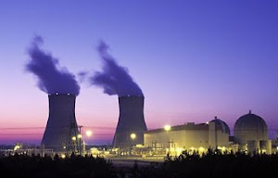
Thank you for your attention
.

